Slide 1

Anomaly Detection in Multivariate Time series Data using Transformer Network
BE Project Review 4 GROUP – 4
Guide : Dr. Rahul Desai
Members
4410 Akash Singh
4420 Dipankar Kumar Singh
4428 Himanshu Yadav

Slide 2

Anomaly Detection in Multivariate Time series Data using Transformer Network

Slide 3
Abstract
Anomaly detection is examining specific data points and detecting rare occurrences that seem suspicious because they’re different from the established pattern of behaviors. Anomaly detection isn’t new, but as data increases manual tracking is impractical.

Slide 4
Finding them helps prevent harm to your system before they occur. For example, a hospital that doesn’t know what an attack will look like can benefit from predictability. With predictability, the hospital can write rules to prevent the attack, protect sensitive data, and their environment.

Slide 5

Introduction

Slide 6

multivariate time series data
Multivariate: There are multiple variables or features recorded simultaneously. For instance, in a manufacturing environment, variables could include temperature, pressure, and humidity, all recorded over time.
Time Series: Data is collected over a continuous or discrete period of time. Time series data implies that the values of the variables are recorded in a sequential order.

Slide 7

Data Set

Slide 8
Multiple Famous multivariate data set
Server Machine Dataset (SMD): SMD was published in 2019, which lasts for 5 weeks long, monitors 28 server machines for a large Internet company with 33 sensors. SMD is one of the largest public datasets currently available for evaluating multivariate time-series anomaly detection. It contains metrics like CPU load, network usage, memory usage, etc.
Soil Moisture Active Passive (SMAP) satellite and Mars Science Laboratory (MSL) rover Datasets: SMAP and MSL are two datasets published by NASA (2018). SMAP contains 55 entities, and each entity is monitored by 25 sensors. MSL contains 27 entities and 66 sensors for each entity. The metrics in the two datasets include telemetry data, radiation, temperature, power, computational activities, etc.

Slide 9
MIT-BIH Supraventricular Arrhythmia Database (MBA): is a collection of electrocardiogram recordings from four patients, containing multiple instances of two different kinds of anomalies (either supraventricular contractions or premature heartbeats. This is a popular large-scale dataset in the data management community Secure Water Treatment (SWaT) dataset : This dataset is collected from a real-world water treatment plant with 7 days of normal and 4 days of abnormal operation. This dataset consists of sensor values (water level, flow rate, etc.) and actuator operations (valves and pumps).

Slide 10
Water Distribution (WADI) dataset : This is an extension of the SWaT system, but had more than twice the number of sensors and actuators than the SWaT model. The dataset is also collected for a longer duration of 14 and 2 days of normal and attack scenarios
Multi-Source Distributed System (MSDS) Dataset: This is a recent high-quality multi-source data composed of distributed traces, application logs, and metrics from a complex distributed system. This dataset is specifically built for AI operations, including automated anomaly detection, root cause analysis, and remediation.

Slide 11

Methodology

Slide 12
Problem Formulation
We consider a multivariate time-series, which is a timestamped sequence of observations/datapoints of size 𝑇.
where each datapoint 𝑥𝑡 is collected at a specific timestamp 𝑡 and
T = {𝑥1, . . . , 𝑥𝑇 },
Anomaly Detection: Given a training input time-series T, for any unseen test time-series T, we need to predict Y = {𝑦1, . . . , 𝑦𝑇ˆ }, where we use 𝑦𝑡 ∈ {0, 1} to denote whether the datapoint at the 𝑡-th timestamp of the test set is anomalous (1 denotes an anomalous datapoint).

Slide 13
Data Preprocessing
To make our model more robust, we normalize the data and convert it to time-series windows, both for training and testing.
Knowing the ranges, we normalize the data to get it in the range [0, 1).

Slide 14

Transformer Model
Transformers are popular deep learning models that have been used in various natural language and vision processing tasks
It is similar to Encoder-decoder models, in a transformer, an input sequence undergoes several attention-based transformations
The encoder encodes the complete sequence until the current timestamp 𝐶 with a focus score.

Slide 15
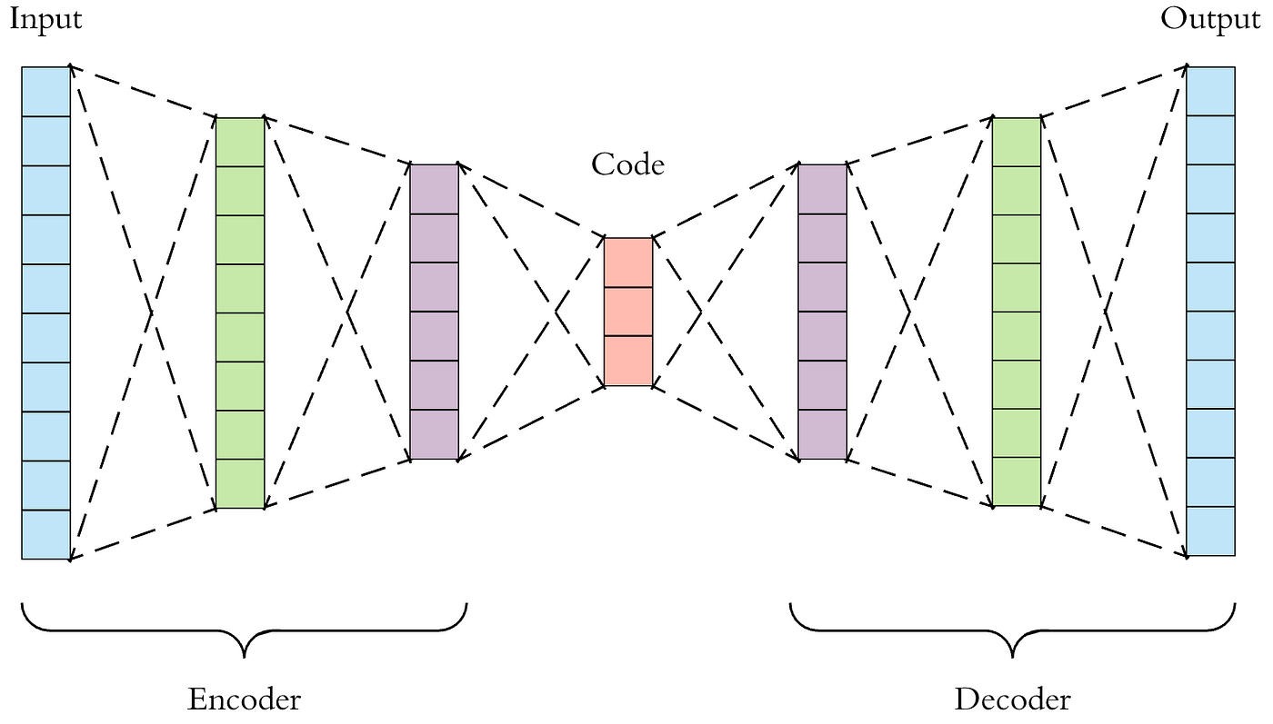
Encoder – Decoder Model

Slide 16

Positional Encoding
Positional encoding is a technique used in the field of natural language processing (NLP), particularly in the context of sequence-to-sequence models like transformers. In these models, the input sequences are typically processed as a set of tokens, without inherent ordering like in recurrent neural networks or convolutional neural networks.
However, since the order of tokens in a sequence carries important information, positional encoding is introduced to provide the model with information about the position of each token in the sequence. This helps the model differentiate between tokens based on their position and prevents the loss of positional information during processing.
Positional encoding is usually added to the input embeddings of tokens before feeding them into the transformer model. There are several ways to encode positional information, but a common method is to use sine and cosine functions with different frequencies and offsets. These functions generate a unique encoding for each position in the sequence, which is then added to the corresponding token embedding.

Slide 17
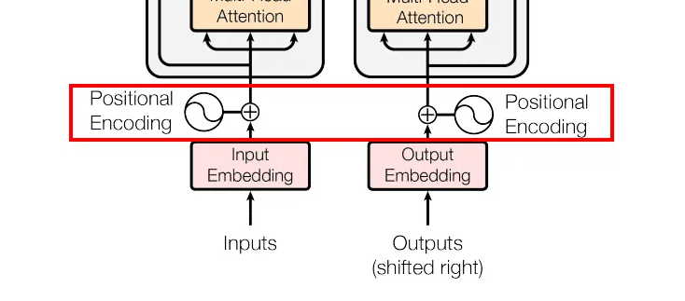
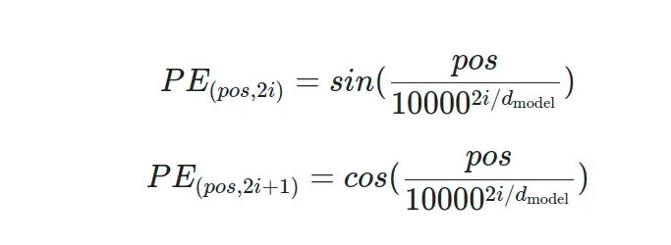
Positional Encoding

Slide 18
By incorporating positional encoding, transformer models can effectively handle sequences of variable length and capture the sequential dependencies within the data more accurately, making them well-suited for a wide range of NLP tasks such as language translation, text summarization, and language understanding.

Slide 19

Use of Multi-Headed Attention
Multi-Head Attention allows the model to jointly attend to information from different representation sub-spaces at different positions Multi-Head Attention in simple terms is like having the ability to pay attention to multiple parts of the story simultaneously. Instead of just looking at one piece of information at a time, the model can look at different parts of the information and understand them together. It's like being able to juggle and process several important details all at once, which helps in better understanding the whole picture.

Slide 20
GAN Style Model
As GAN models have been shown to perform well in characteristic tasks of whether an input is anomalous or not, we leverage a time-efficient GAN style adversarial training method
Our model consists of two transformer encoders and two decoders
We consider the model inference in two phases, this method generate attention weights using the input timeseries windows and the complete sequence to capture temporal trends within the input sequences

Slide 21
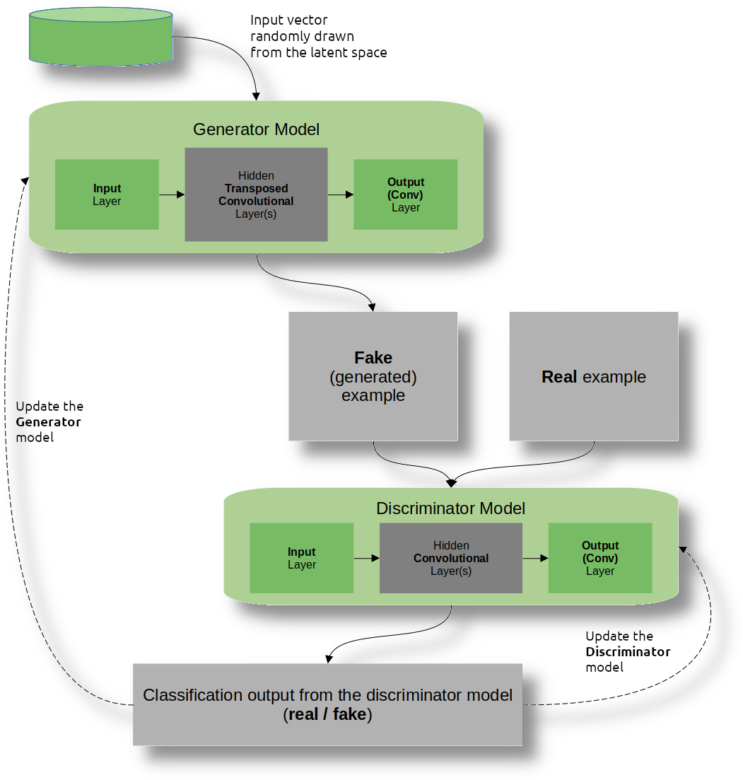
Generative adversarial network Model

Slide 22
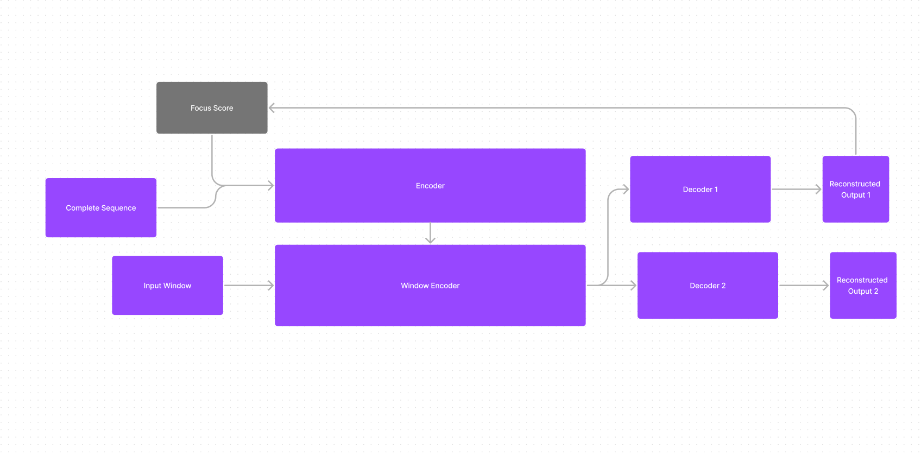
High Level Architecture Diagram

Slide 23
Offline Two-Phase Adversarial Training
Phase 1 - Input Reconstruction Phase 2 - Focused Input Reconstruction

Slide 24
Phase 1 - Input Reconstruction
The Transformer model enables us to predict the reconstruction of each input time-series window. It does this by acting as an encoder-decoder network at each timestamp. However, traditional encoder-decoder models often are unable to capture short-term trends and tend to miss anomalies if the deviations are too small

Slide 25

Phase 2 - Focused Input Reconstruction
In the second phase, we use the reconstruction loss for the first decoder as a focus score. The focus score generated in the first phase indicates the deviations of the reconstructed output from the given input. This acts as a prior to modify the attention weights in the second phase and gives higher neural network activation to specific input sub-sequences to extract short-term temporal trends.

Slide 26

Our Contribution
Using Modified Transformer model ( Dual Encoder and Decoder) which will result in dealing with noisily data and produce better result in capturing short term as well as long term trends in time series data along with efficient computing, our model is able to utilize parallel computation making is faster than other traditional ML and Deep Learning Model.

Slide 27

Software Used
Pandas
Python
matplotlib
Dgl : DEEP GRAPH LIBRARY
numpy
SciencePlots
scikit-learn
Xlrd

Slide 28
Reference
[1] Hossein Abbasimehr, Mostafa Shabani, and Mohsen Yousefi. 2020. An optimized model using LSTM network for demand forecasting. Computers & industrial engineering 143 (2020), 106435.
[2] Subutai Ahmad, Alexander Lavin, Scott Purdy, and Zuha Agha. 2017. Unsupervised real-time anomaly detection for streaming data. Neurocomputing 262 (2017), 134–147.
[3] Chuadhry Mujeeb Ahmed, Venkata Reddy Palleti, and Aditya P Mathur. 2017. WADI: a water distribution testbed for research in the design of secure cyber physical systems. In Proceedings of the 3rd International Workshop on CyberPhysical Systems for Smart Water Networks. 25–28.
[4] Julien Audibert, Pietro Michiardi, Frédéric Guyard, Sébastien Marti, and Maria A Zuluaga. 2020. USAD: UnSupervised Anomaly Detection on Multivariate Time Series. In Proceedings of the 26th ACM SIGKDD International Conference on Knowledge Discovery & Data Mining. 3395–3404.
[5] Tharindu R Bandaragoda, Kai Ming Ting, David Albrecht, Fei Tony Liu, and Jonathan R Wells. 2014. Efficient anomaly detection by isolation using nearest neighbour ensemble. In 2014 IEEE International Conference on Data Mining Workshop. IEEE, 698–705.
[6] Julian Bellendorf and Zoltán Ádám Mann. 2020. Classification of optimization problems in fog computing. Future Generation Computer Systems 107 (2020), 158–176.
[7] Nejc Bezak, Mitja Brilly, and Mojca Šraj. 2014. Comparison between the peaksover-threshold method and the annual maximum method for flood frequency analysis. Hydrological Sciences Journal 59, 5 (2014), 959–977.
[8] Paul Boniol, Michele Linardi, Federico Roncallo, and Themis Palpanas. 2020. Automated anomaly detection in large sequences. In 2020 IEEE 36th International Conference on Data Engineering (ICDE). IEEE, 1834–1837.

Slide 29

Thank You

